Slide 1

“Mapping the Global Impact of 2.3.4.4b H5 HPAI: Phylogeography, Extinction Risk, and Societal-Ecological-Economic Consequences.”
Tanin Rajamand

Slide 2
Data Used
IUCN Red List of Threatened Species
List of Threatened Species
GISAID: H5Nx
Sequence data from 1/1/1996 to 5/2/2024
Global dataset in every species available excluding environmental sequences
Only downloaded complete H5 sequences
Number of sequences = 12518
Cattle Movement
Data from Tavis Anderson and Mike Sanderson
Bird Migration Patterns
U.S. Fish & Wildlife Service
Bird Habitat
Location of each species
Poultry Trade Data
USDA
US poultry data

Slide 3
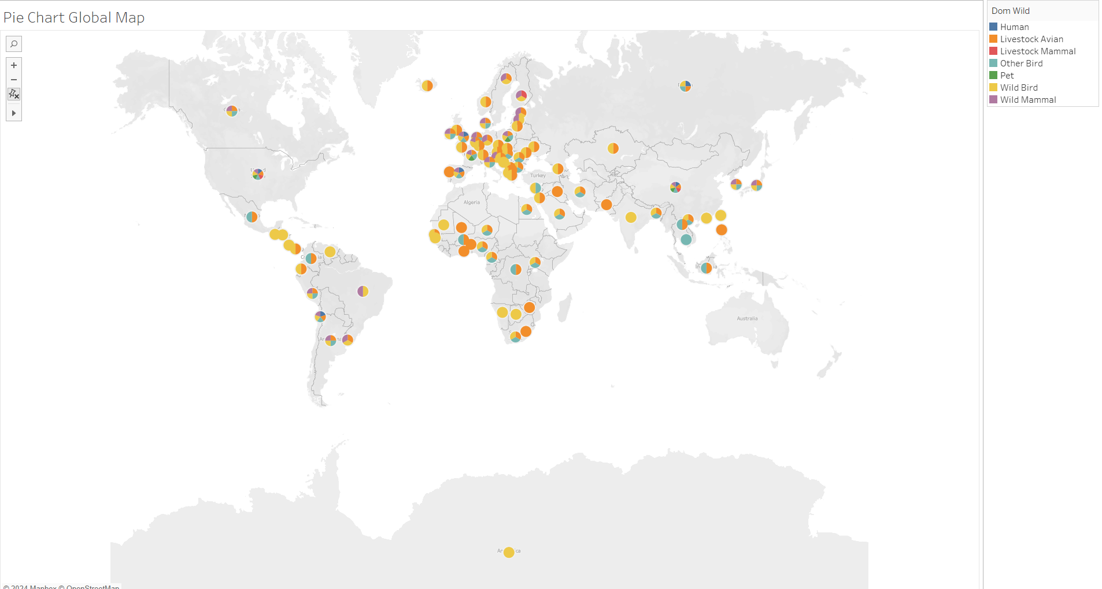
Global Dataset – analysis 1

Slide 4
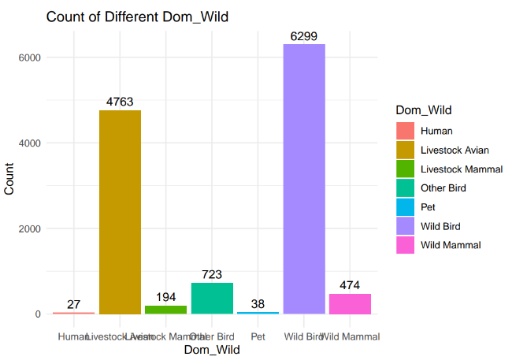
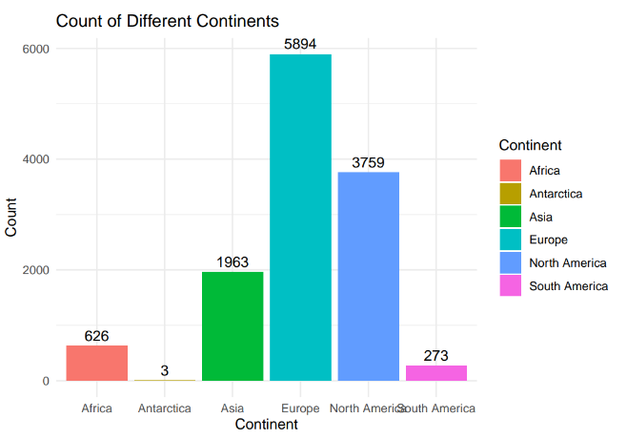

Slide 5
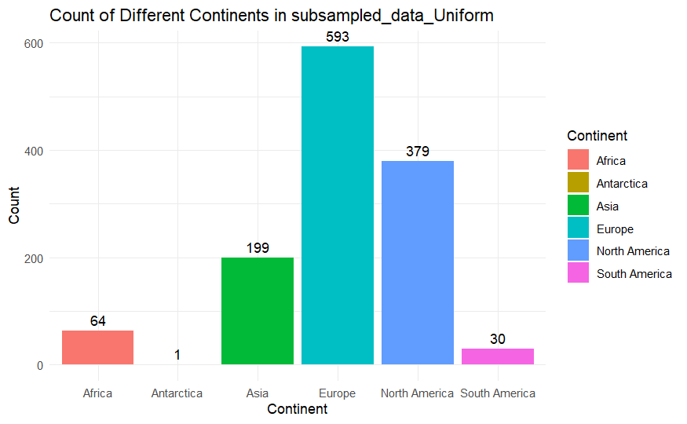
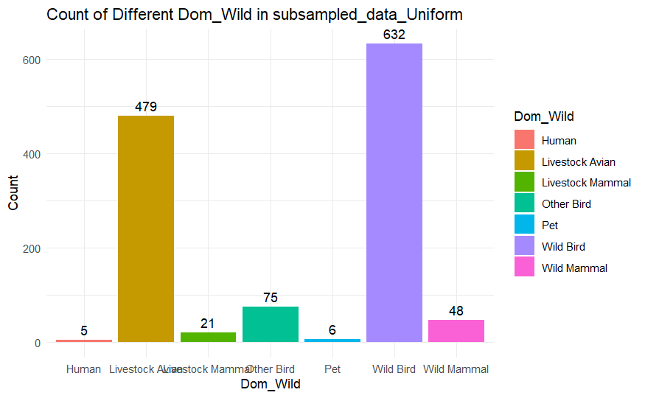
Subsampling
Uniform:
10% from each category of Continent and Host
62 from each category against both the Continent and the Host
Nextstrain
Weighted subsampling that weights sequence data against case data
There was not good enough info for the flu

Slide 6
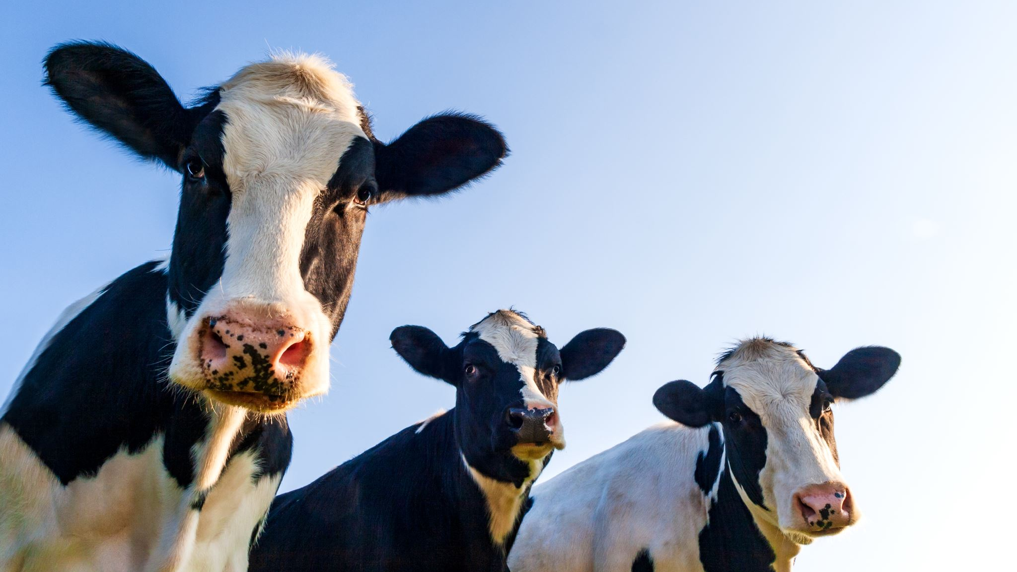
Us Dataset (Analysis 2) for the Cattle Movement

Slide 7
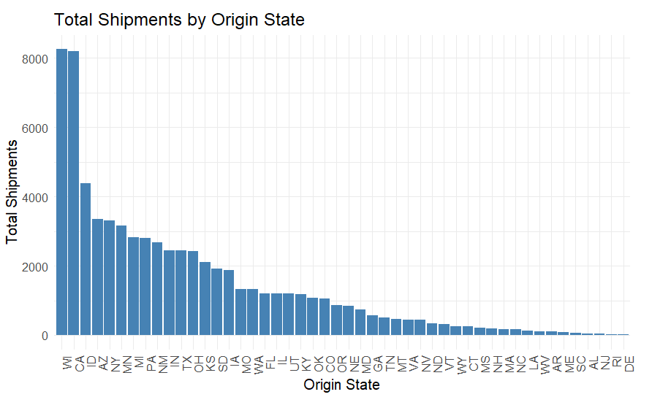
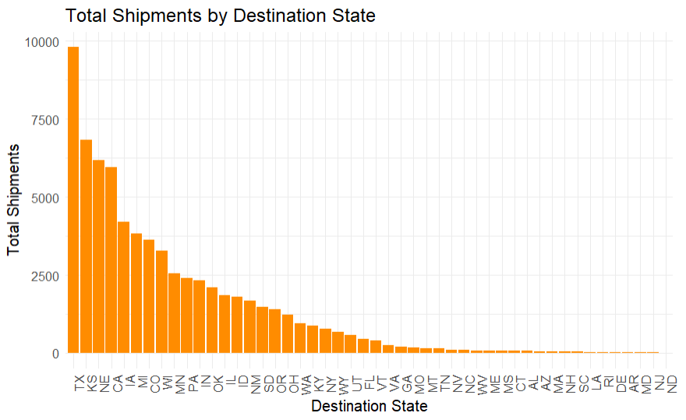

Slide 8
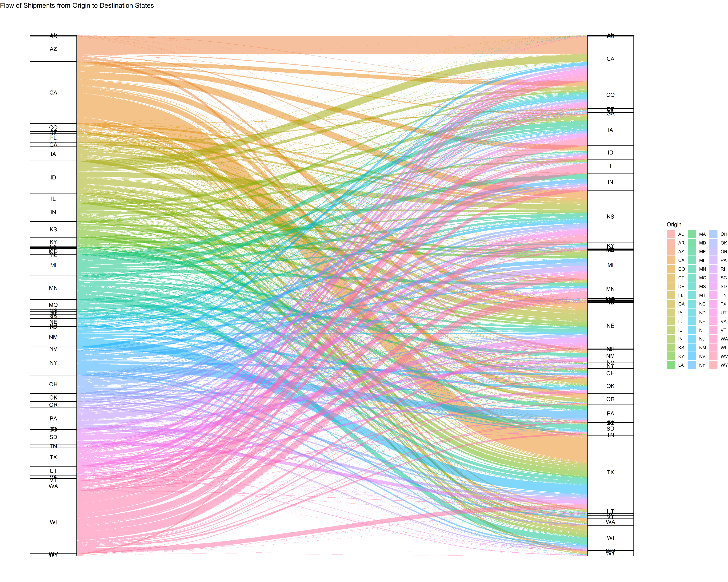

Slide 9
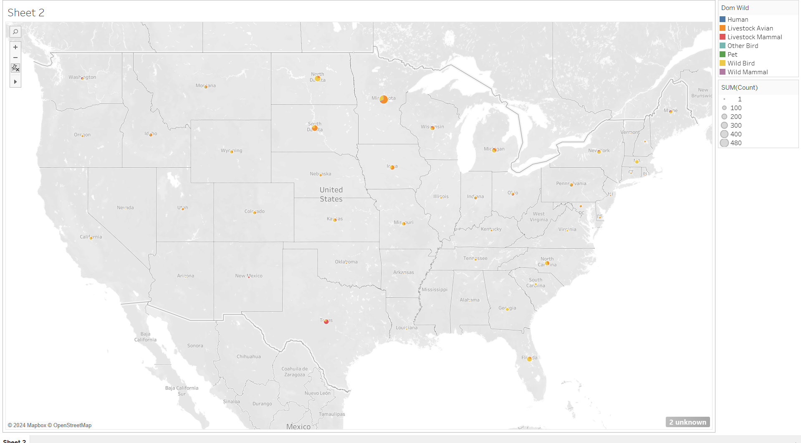
Map of US Sequences from GISAID

Slide 10
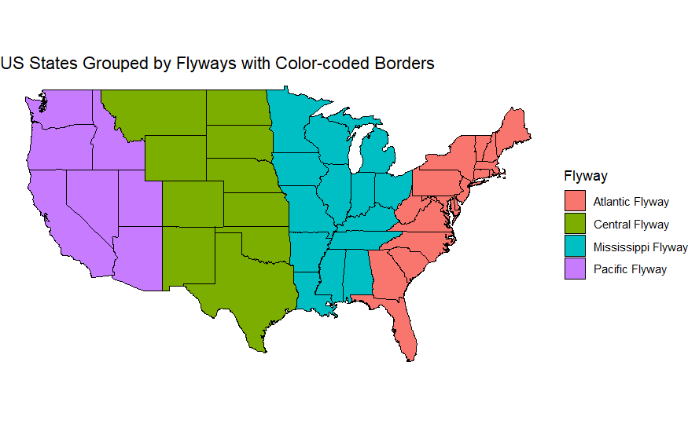

Slide 11
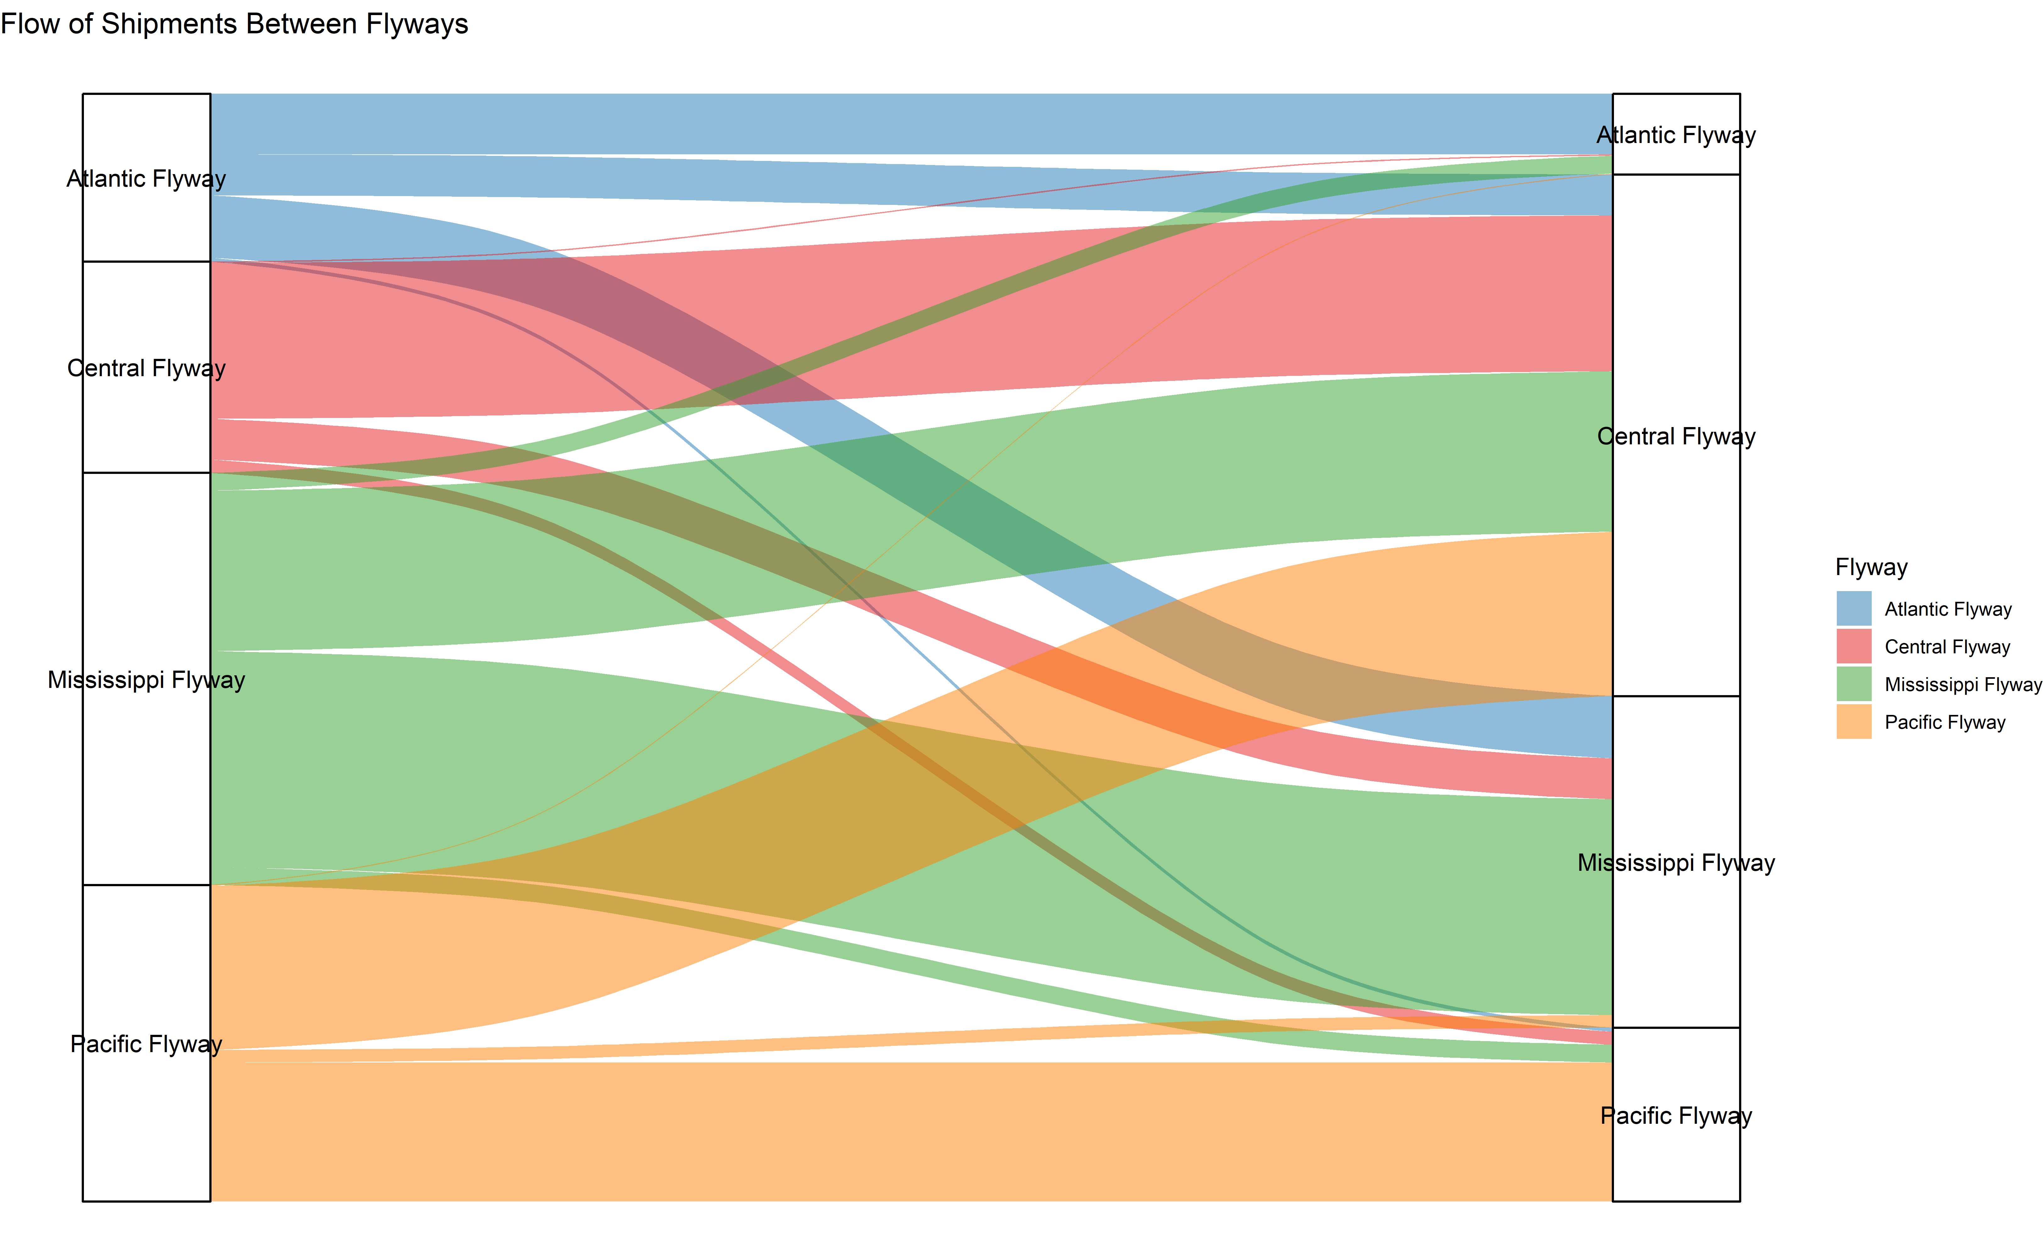
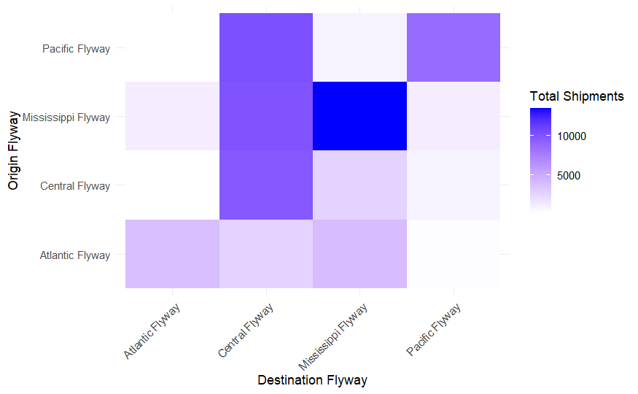

Slide 12
